Slide 1
PC2232-Supplementary Notes
Topic: Derivation of Fresnel Equations
Sow Chorng Haur
Blk S12, 02-19 or Blk S11 02-10
Email: physowch@nus.edu.sg

Slide 2
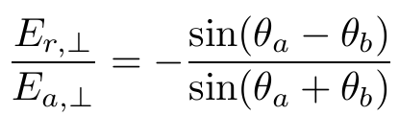


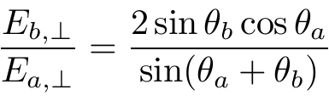



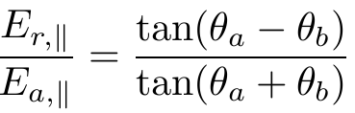


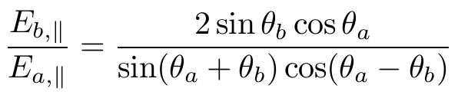

Fresnel’s Equations
For angles different from polarizing angle, it can be shown that the magnitudes of E-fields for polarizations wrt plane of incidence satisfies the Fresnel Equations:
  Perpendicular (⊥) or s-polarized (s for German senkrecht )
  Parallel (//) or p-polarized.

Slide 3




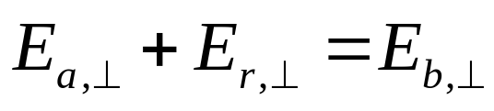

  Let’s start with the Perpendicular (⊥) or s-polarized wave
The magnetic Fields B for these waves are indicated by the blue arrows.
In electromagnetism, the tangential components of the Electric Field at the interface of two materials must be continuous. i.e.
(1)
Similarly, the tangential components of the Magnetic Field at the interface is continuous.
(assume μ is same for these materials)

Slide 4





  Let’s start with the Perpendicular (⊥) or s-polarized wave
Similarly, the tangential components of the Magnetic Field at the interface is continuous.
(assume μ is same for these materials).
Thus consider the component along x-directions, we have
(2)

Slide 5


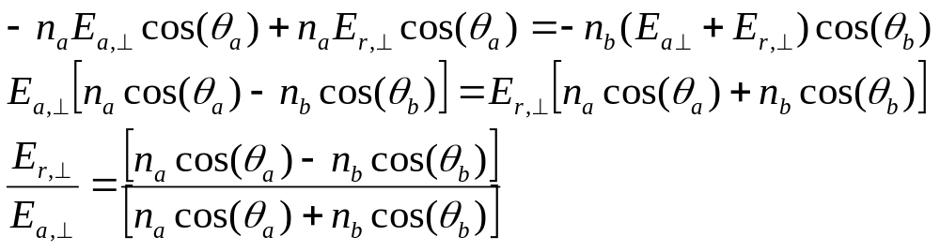
  Let’s start with the Perpendicular (⊥) or s-polarized wave
Now we can work with both equation (1) and (2)
(1)
(2)
Note that
Eqn (2) becomes
Substitute (1)

Slide 6
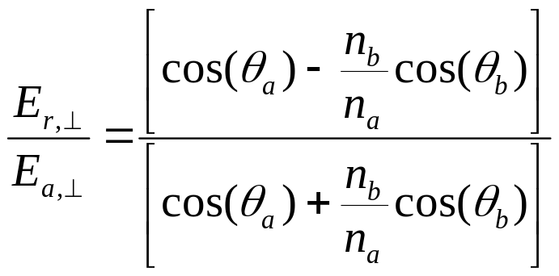
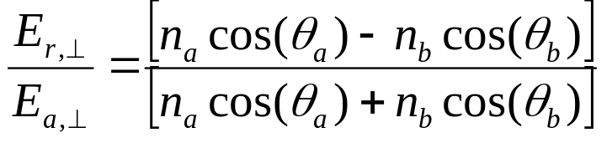
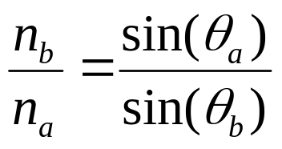
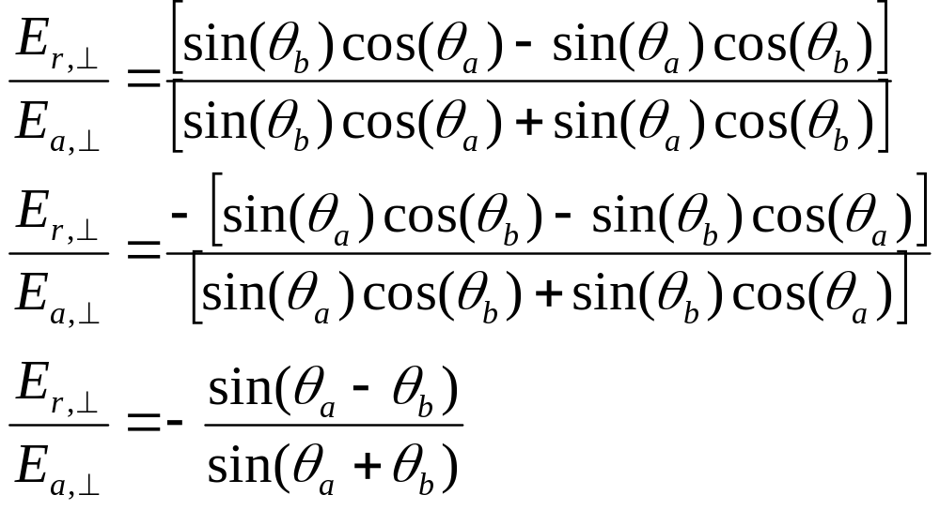
  Let’s start with the Perpendicular (⊥) or s-polarized wave
➔
Note that
substitute into above eqn. We have

Slide 7
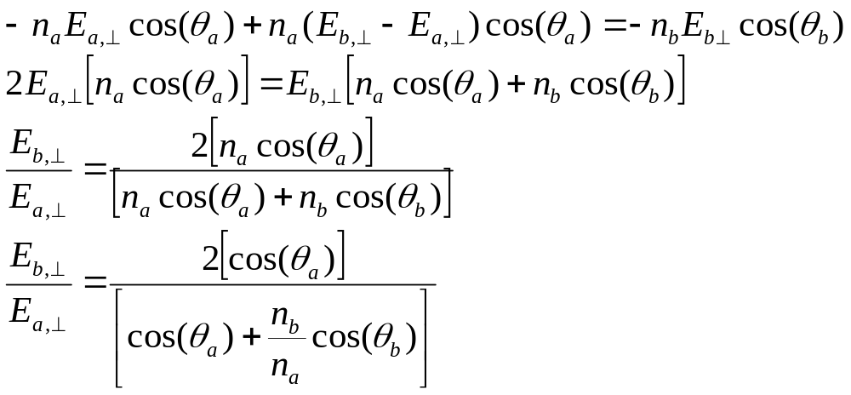
  Let’s start with the Perpendicular (⊥) or s-polarized wave
Now we can work with both equation (1) and (2)
(1)
(2)
Note that
Eqn (2) becomes
Substitute (1) with the aim to relate E_{a} to E_{b}

Slide 8
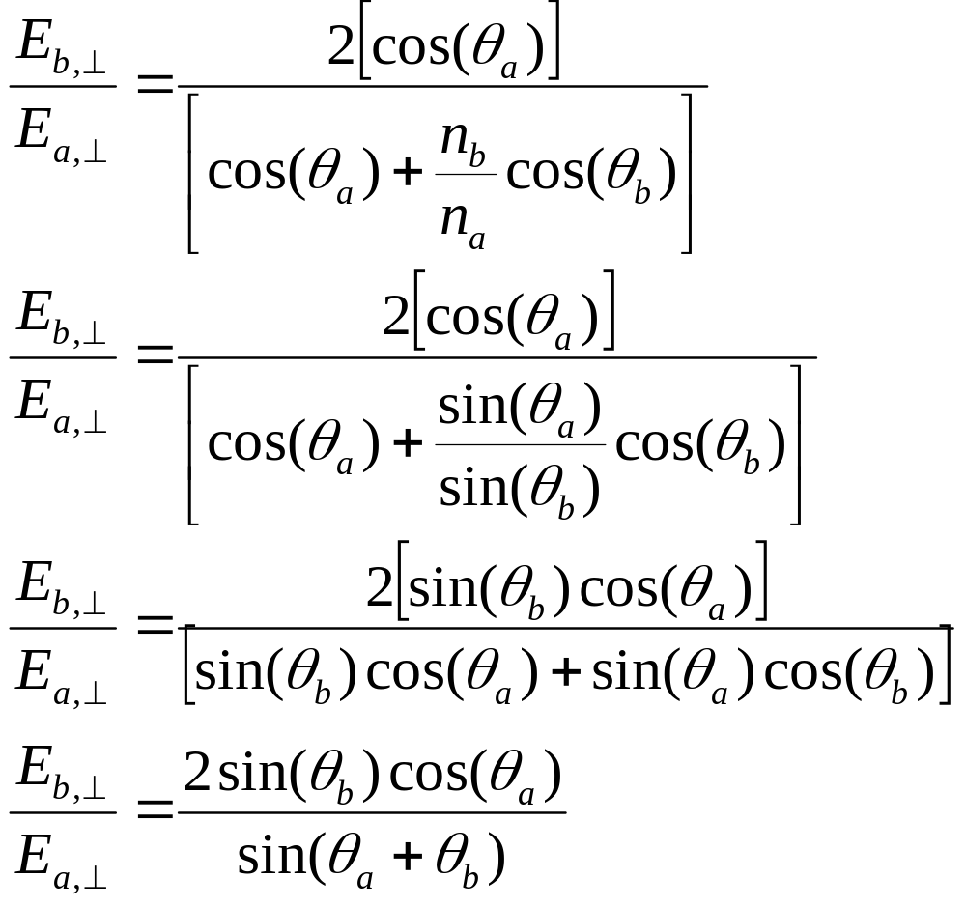
  Let’s start with the Perpendicular (⊥) or s-polarized wave
Continue from previous slide

Slide 9



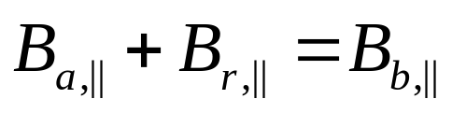
  Let’s consider Parallel (//) or p-polarized
The magnetic Fields B for these waves are indicated by the blue circles (i.e. pointing one of the plane).
Similar to the case for s-polarized wave, matching the tangential components of the Electric Field and Magnetic Field at interface
(3)

Slide 10




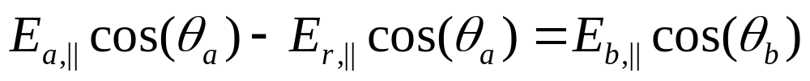
  Let’s consider Parallel (//) or p-polarized
(4)

Slide 11
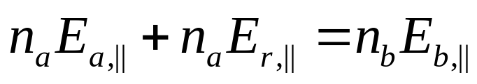
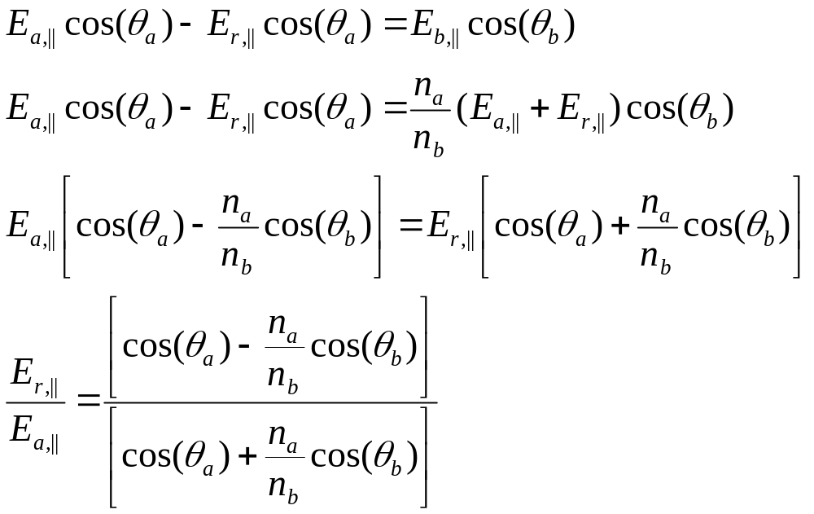
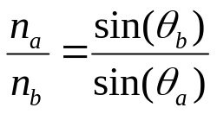
  Let’s consider Parallel (//) or p-polarized
Now we can work with both equation (3) and (4)
(3)
(4)
Note that
Eqn (3) becomes
Substitute into (4)

Slide 12
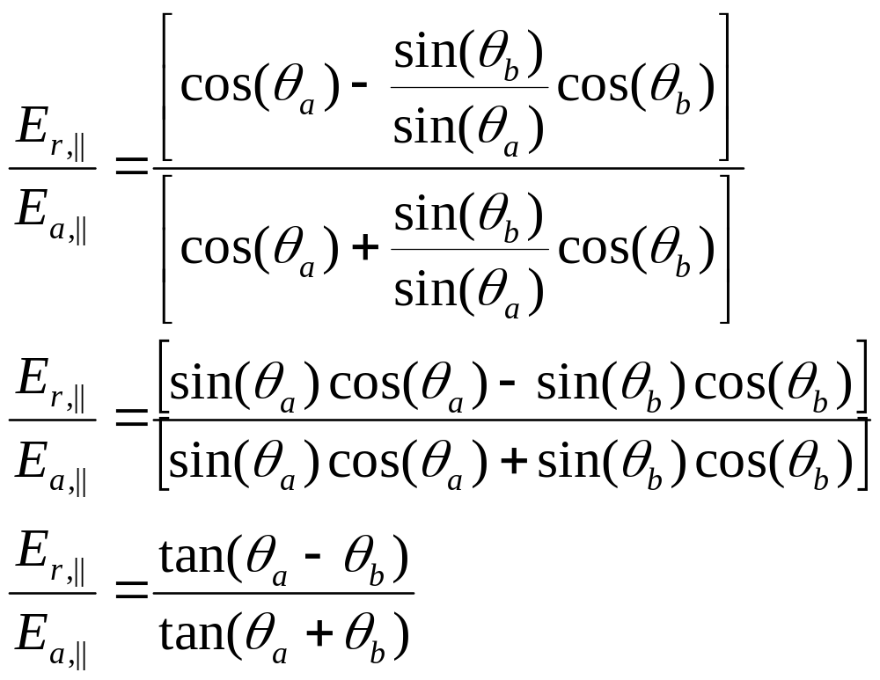
  Let’s consider Parallel (//) or p-polarized
Continue from previous slide

Slide 13
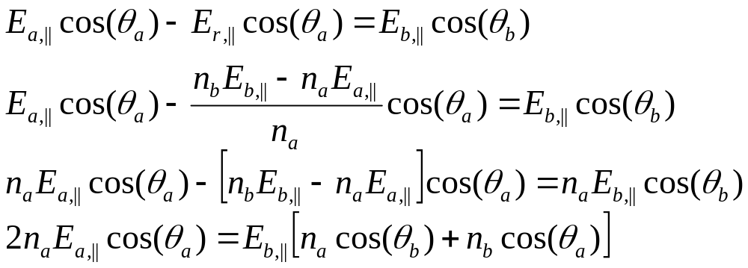
  Let’s consider Parallel (//) or p-polarized
Now we can work with both equation (3) and (4)
(3)
(4)
Note that
Eqn (3) becomes
Substitute into (4)

Slide 14
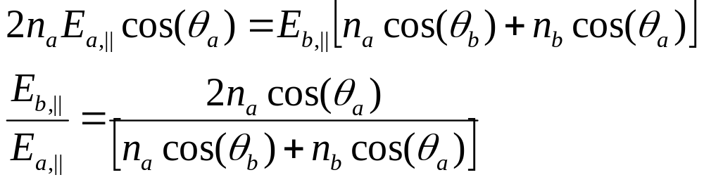
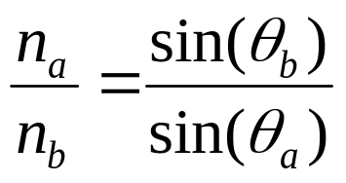
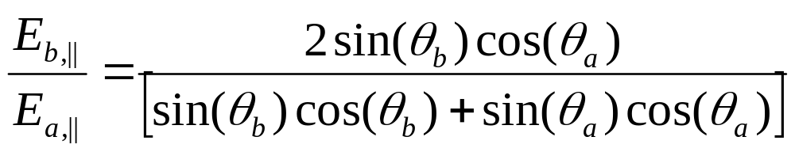
  Let’s consider Parallel (//) or p-polarized
Continue

